Slide 1
BOOLEAN ALGEBRA
Laws of Boolean Algebra
Boolean Algebra Rules
De Morgan Theorems
Truth Table
Venn Diagrams
Simplification of logic expressions

Slide 2
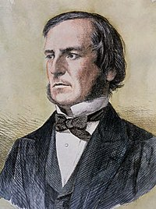
BOOLEAN ALGEBRA
Boolean algebra was introduced by George Boole in 1854. Boolean algebra is a branch of algebra based on true and false values. It is first used by Claude Shannon for designing and analyzing logical circuits.
We can consider Boolean algebra as a system based on three basic logical operations: AND, OR and NOT.
AND operation corresponds to multiplication in binary, OR operation corresponds to addition, and NOT operation corresponds to complement operation.
George Bool

Slide 3
Laws of Boolean Algebra
Commutative, associative, distributive and double negation are the laws of Boolean algebra.
Commutative Law
A + B = B + A
A . B = B . A
Associative Law
(A + B) + C = A + (B + C) = A+B+C
A.B.C = A . (B . C) = (A . B) . C
Distributive Law
A . (B+C) = A . B + A . C
Double Negation Law
(A’)’ = A

Slide 4
Boolean Algebra Rules
These rules are useful when simplifying logical expressions.
A + 0 = A
1 + 0 = 1
0 + 0 = 0
A + 1 = 1
1 + 1 = 1
0 + 1 = 1
A . 0 = 0
1 . 0 = 0
0 . 0 = 0
A . 1 = A
1 . 1 = 1
0 . 1= 0

Slide 5
Boolean Algebra Rules
A + A = A
1 + 1 = 1
0 + 0 = 0
A . A = A
1 . 1 = 1
0 . 0 = 0
A + A’ = 1
1 + 0 = 1
0 + 1 =1
A . A’= 0
1 . 0 = 0
0 . 1 = 0
(A’)’ = A

Slide 6
Boolean Algebra Rules
The following rules are frequently used to simplify logical expressions.
A + A.B = A
A.(1+B) = A
A+ B.C = (A+B).(A+C)
(A+B).(A+C)=A.A+A.C+A.B+B.C = A+A.C+A.B+B.C
= A+A.B+B.C=A+B.C
A + A’.B = A+ B
(A+A’)(A+B) = A+B

Slide 7
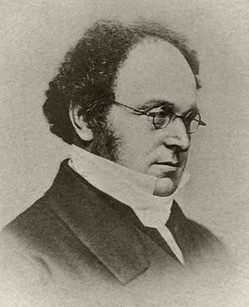
De Morgan Theorems
1st Theorem
(A . B)’ = A’ + B’
2nd Theorem
(A + B)’ = A’ . B’
De Morgan theorems can also be applied to logical expressions with more than two variables.
(A.B.C)’ = A’+ B’+ C’
(A+B+C)’ = A’. B’. C’
Let’s prove that (A+B+C)’ = A'.B'.C'
[A+ (B+C)]’ = A’.(B+C)’ = A’.B’.C’
Augustus De Morgan

Slide 8
Truth Table
Truth table shows all the outputs that corresponds to all possible values that variables can have. If there are n variables in the expression, then the number of combinations is 2^{n}.
There’s a practical method to generate all combinations. The column of LSB is filled with a 0 and a 1 repeatedly. Then the next column is filled with two 0’s and two 1’s repeatedly. The next column is filled with four 0’s and four 1’s repeatedly. And the rest of the columns are filled the same way. The number of 0’s and 1’s increase by the power of 2. (2⁰, 2¹, 2², 2³,…)
A | B | C | Output
0 | 0 | 0
0 | 0 | 1
0 | 1 | 0
0 | 1 | 1
1 | 0 | 0
1 | 0 | 1
1 | 1 | 0
1 | 1 | 1
A | B | Output
0 | 0
0 | 1
1 | 0
1 | 1

Slide 9
Truth Table
Example: Let’s generate the truth table of F(A,B,C) = A+B’C
We can find out all the outputs by writing all the possible values of variables in the equation for all combinations.
The second way to find out all outputs is by interpreting the expression.
We can say that, the output (F) will be 1 if A=1 or B’C=1. For B’C to be 1, B must be 0 and C must be 1.
A | B | C | F
0 | 0 | 0 | 0
0 | 0 | 1 | 1
0 | 1 | 0 | 0
0 | 1 | 1 | 0
1 | 0 | 0 | 1
1 | 0 | 1 | 1
1 | 1 | 0 | 1
1 | 1 | 1 | 1
B=0 and C=1
A=1

Slide 10
Truth Table
Example: Let’s prove De Morgan’s theorem (A+B)’ = A' . B' using truth tables.
If the output columns are identical in truth tables of these two expressions (the one on the left and the one on the right), we can say that these expressions are identical.
A | B | A' | B' | A+B | (A+B)’ | A'.B'
0 | 0 | 1 | 1 | 0 | 1 | 1
0 | 1 | 1 | 0 | 1 | 0 | 0
1 | 0 | 0 | 1 | 1 | 0 | 0
1 | 1 | 0 | 0 | 1 | 0 | 0

Slide 11
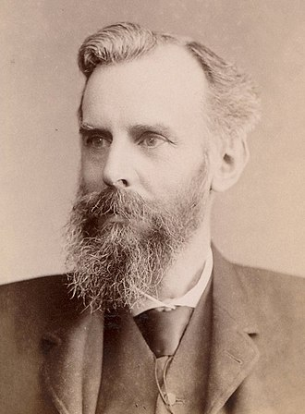
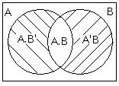
Venn Diagrams
We can use Venn diagrams to visualize logical expressions. Each set represents a variable. Inner part of a set represents the variable itself, and the outer part of a set represents the complement of the variable.
We can prove equations with Venn diagrams.
John Venn

Slide 12
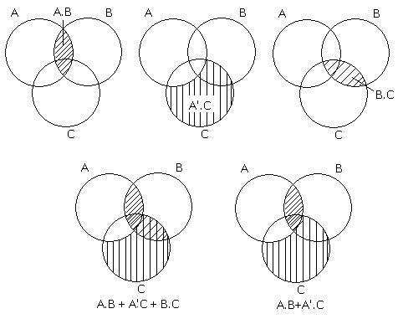
Venn Diagrams
Example: Let’s prove that F(A,B,C) = A.B + A'.C + B.C = A.B + A'.C with Venn diagrams.

Slide 13
Simplification of Logical Expressions
Complicated logical expressions can be simplified using Bool algebra rules. Simplifying logical expression helps us build simpler and cost effective logical circuits. We can simplify expressions by collecting like terms or extending the expression with a term which does not affect the output (e.g. A+A’).
Example: Let’s simplify F(A,B,C)= ABC’+A’B’C+A’BC+A’B’C’
First, we collect like terms. We pull out the common factor (A’B’) from 2nd and 4th terms.
F(A,B,C) = ABC’+A’B’(C+C’)+A’BC A+A’=1 rule applied
= ABC’+ A’B’+A’BC
= ABC’+A’(B’+BC) A+A’B = A+B rule applied
= ABC’+A’(B’+C)
= ABC’+A’B’+A’C

Slide 14
Simplification of Logical Expressions
Example: Let’s simplify F(A,B,C) = A.B + A'.C + B.C
We can extend the term B.C with (A+A’).
F(A,B,C) = A.B + A'.C + B.C.(A+A') = A.B + A'.C + A.B.C + A'.B.C
= A.B.(1+C) + A'.C.(1+B) = A.B +A'.C
Example: Let’s simplify F(A,B,C) = AB ’+ A(B+C)’ + B(B+C)’
We apply De Morgan theorems to the 2nd and 3rd terms.
F(A,B,C) = AB’+A(B’C’)+B(B’C’) B.B’= 0.
= AB’+AB’C’ Pull out AB’
= AB’(1+C’) 1+C’=1
= AB’

